Slide 1
기초SOC설계 프로젝트
20191495 백우성
20221558 박준영
GitHub : https://github.com/Park-Joonyoung/CSE4178-01-SOC-Design-Group-4

Slide 2
CONTENTS
01. Vivado Code
02. Block Diagram
03. Vitis Code
04. Result

Slide 3
8x8 Matrix Arithmetic Operation
SOGANG UNIVERSITY
Mode 0 : Matrix Summation
Mode 1 : Hadamard Multiplication
Mode 2 : Matrix Multiplication

Slide 4
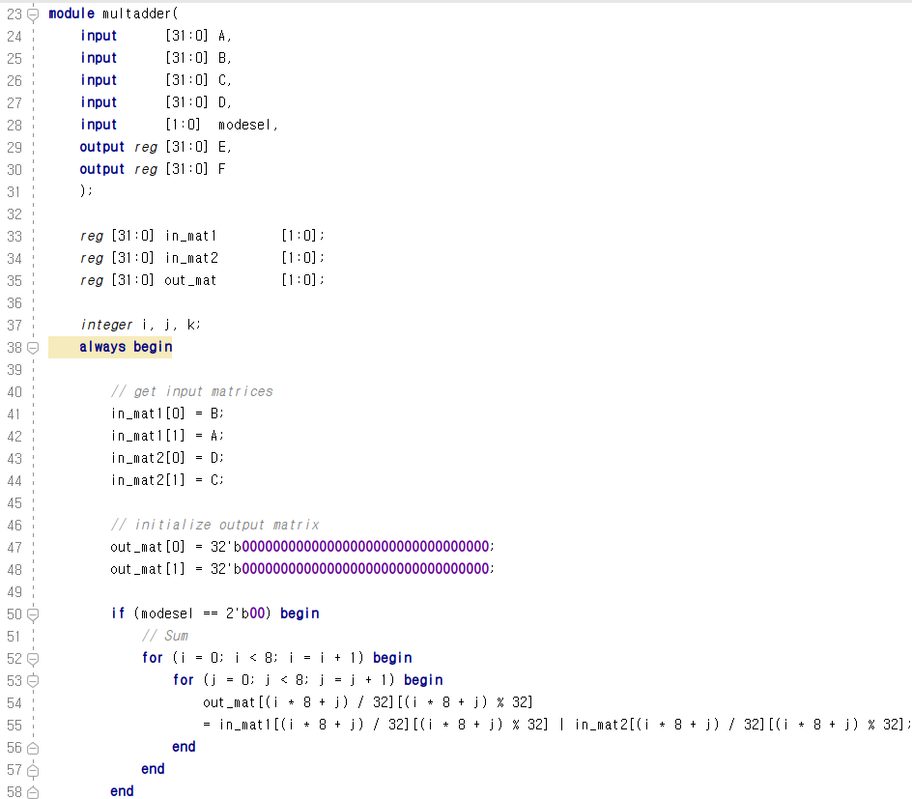
32 bit register x 2 → 8X8 Binary Matrix
Mode 0 : Bitwise Matrix Summation
Input matrix 1
Input matrix 2
Mode 0

Slide 5
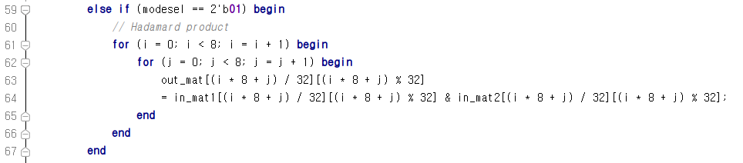
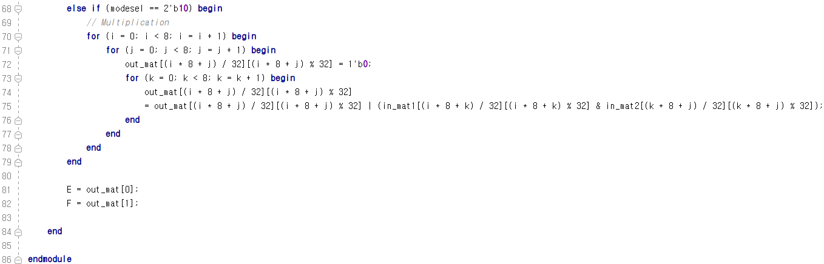
Mode 1
Mode 1 : Bitwise Hadamard Multiplication
Mode 2 : Bitwise Matrix Multiplication
Mode 2

Slide 6
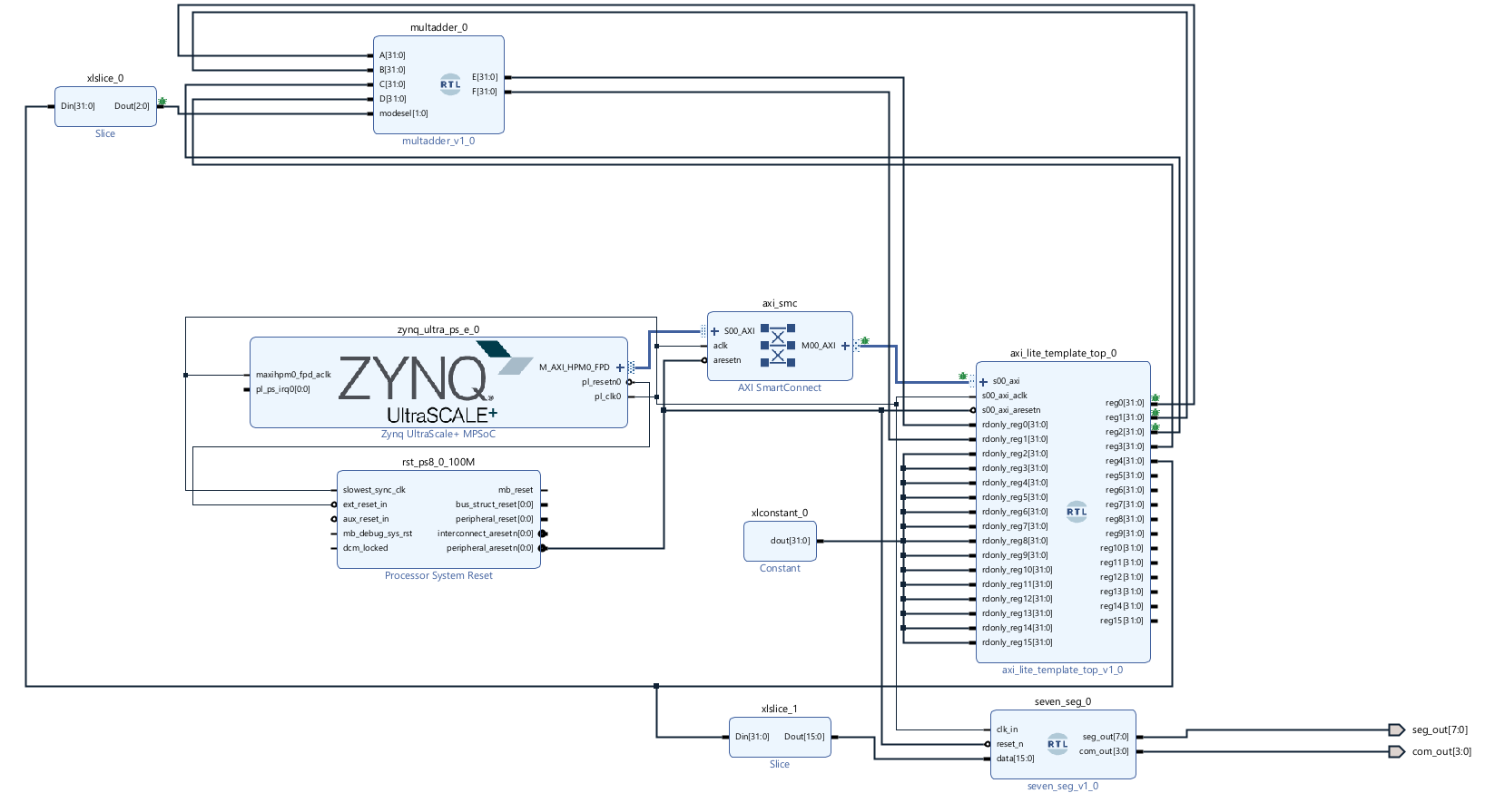
Input Matrix
Output Matrix
ModeSel

Slide 7
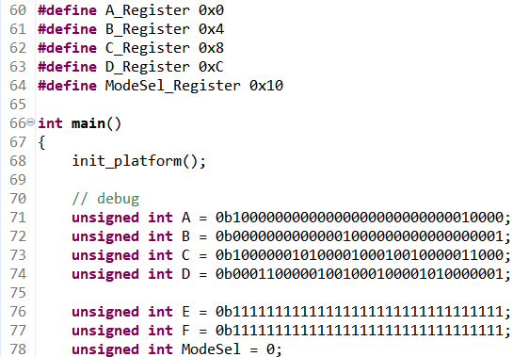
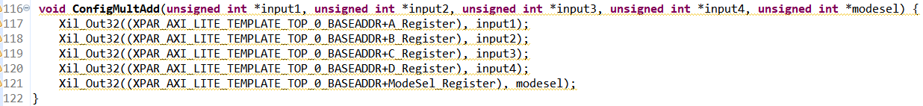
Input matrix1 (reg A ,reg B)
Input matrix2 (reg C ,reg D)
Mode Select (reg ModeSel)
Output matrix (reg E, reg F)

Slide 8
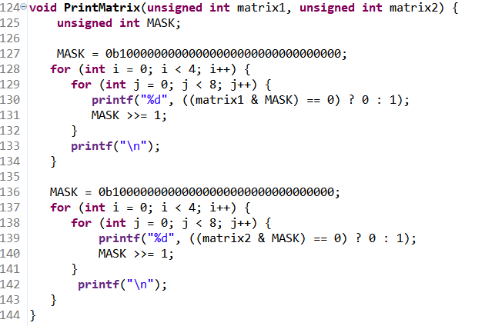
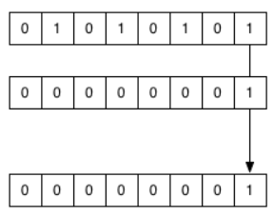
PrintMatrix code using bit masking
>> bit shift
&

Slide 9
10000000
00000000
00000000
00010000
00000000
00000100
00000000
00000001
10000001
01000010
00100100
00011000
00011000
00100100
01000010
10000001
10000001
01000010
00100100
00011000
00011000
00100100
01000010
10000001
Mode 0
Bitwise Matrix Summation
+
=
10000000
00000000
00000000
00010000
00000000
00000100
00000000
00000001
10000001
01000010
00100100
00011000
00011000
00100100
01000010
10000001
10000000
00000000
00000000
00010000
00000000
00000100
00000000
00000001
Mode 1
Bitwise Hadamard Multiplication
*
=
10000000
00000000
00000000
00010000
00000000
00000100
00000000
00000001
10000001
01000010
00100100
00011000
00011000
00100100
01000010
10000001
=
10000001
00000000
00000000
00011000
00000000
00100100
00000000
10000001
Mode 2
Bitwise Matrix Multiplication
X

Slide 10
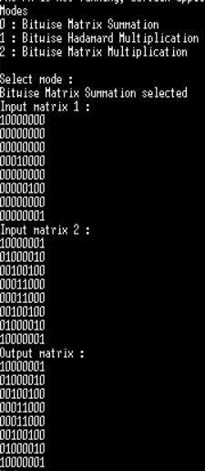
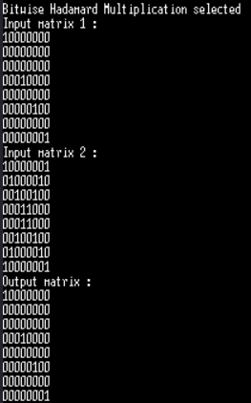
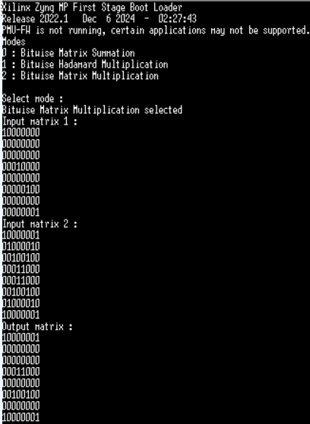
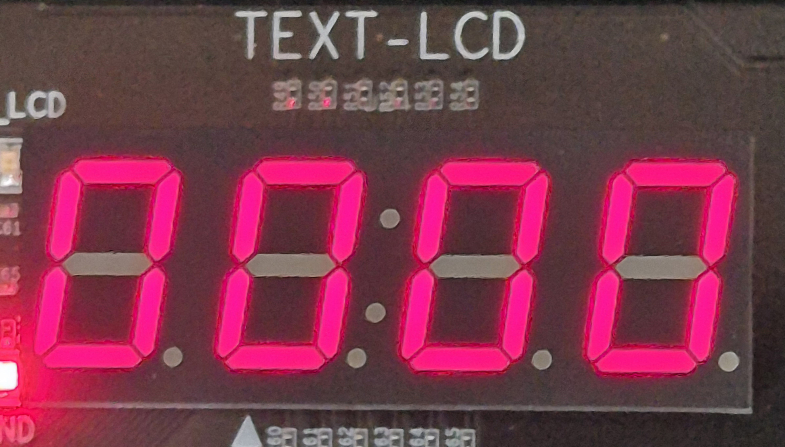
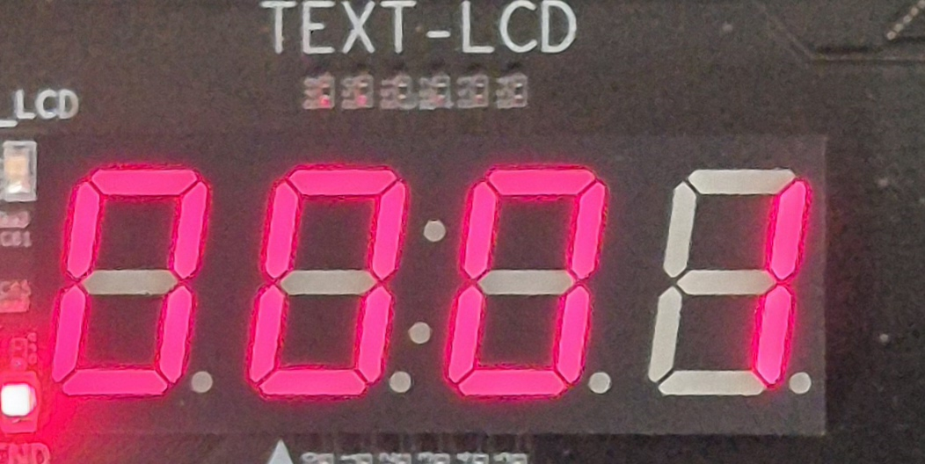
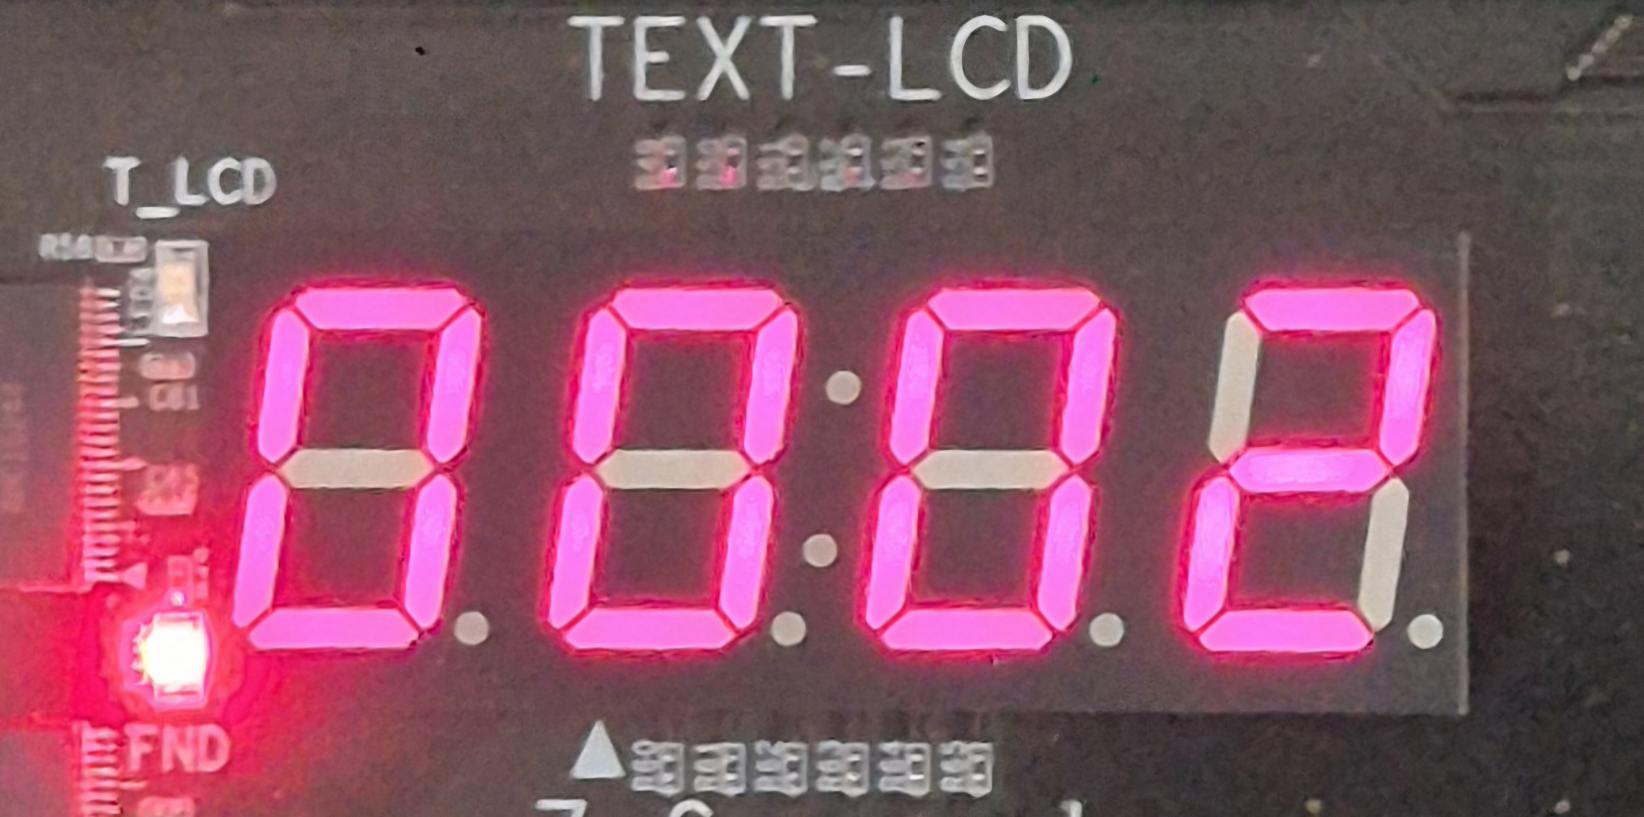
Mode 0 | Mode 1 | Mode 2

Slide 11
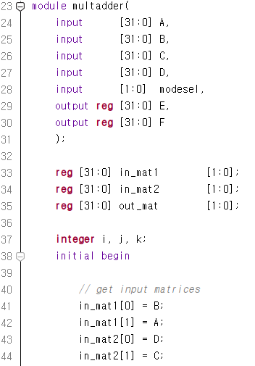
Do not use initial in module
Use initial only in testbench files

Slide 12
Thank you!

